Slide 1
Visualizing Real-time Hypothetical Scenarios in Tableau
Sinji Yang
Notes:
Good afternoon. My name is Sinji Yang. Welcome to my session. I am a BI analyst at the University of Michigan. Today, we will talk about …

Slide 2



Data-driven Decision-making Process What is missing in this picture?
Collect Data
Analyze Data
Make Decision
Notes:
When performing data-driven decision-making process, we follow these steps. We collect data, we analyze data, then we make decision based on the data. But… what is missing in this picture? To me, an “option” of what-if scenario analysis is missing from this picture. Because there are so many uncertainties facing us.

Slide 3

What if we add hypothetical scenarios?
Notes:
What if we add hypothetical scenarios to the report?

Slide 4


What if we add hypothetical data?
Hypothetical
Data
Real
Data
Real
Data
Real
Data
Notes:
What if we add hypothetical data to our real data?

Slide 5

What if we add “real-time” hypothetical data & scenarios to Tableau and visualize it?
Scenarios
Notes:
What if we add real-time hypothetical data and scenarios to Tableau and visualize it? Isn’t this wonderful?

Slide 6
Benefits of What-If Scenario Analysis
WISA
WISA can
Help evaluate possible outcomes & impacts
Show how results change when key factors are changed
Help brainstorming
Promote thinking outside the box
Trigger new ideas or see potential opportunities
Consider alternatives
Improve decision making quality
Reduce uncertainty or surprise
Provide a more informed decision-making process
Notes:
Before we move on, let’s look at the benefits of what-if scenario analysis.

Slide 7
Add WISA to Tableau
Notes:
So, let’s see how to add WISA to Tableau.

Slide 8
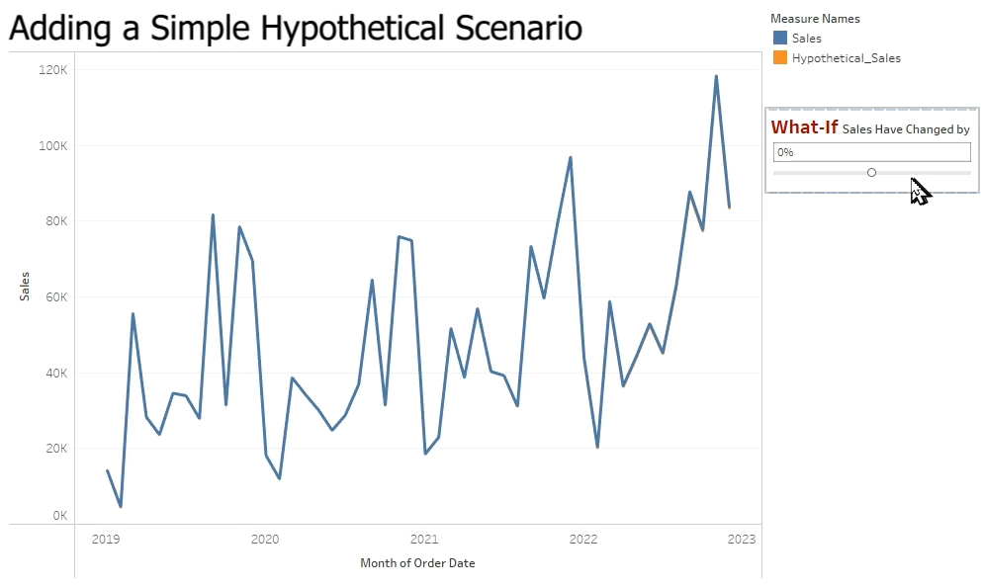
Notes:
First, let’s add a simple hypothetical scenario to Tableau, and it doesn’t require additional data to be added. We hypothesize that the sales would change by so-and-so many percent. And we visualize it. But often, this kind of simple model is not enough for decision making. Sometimes, we really want to add data and scenarios to our report immediately.

Slide 9
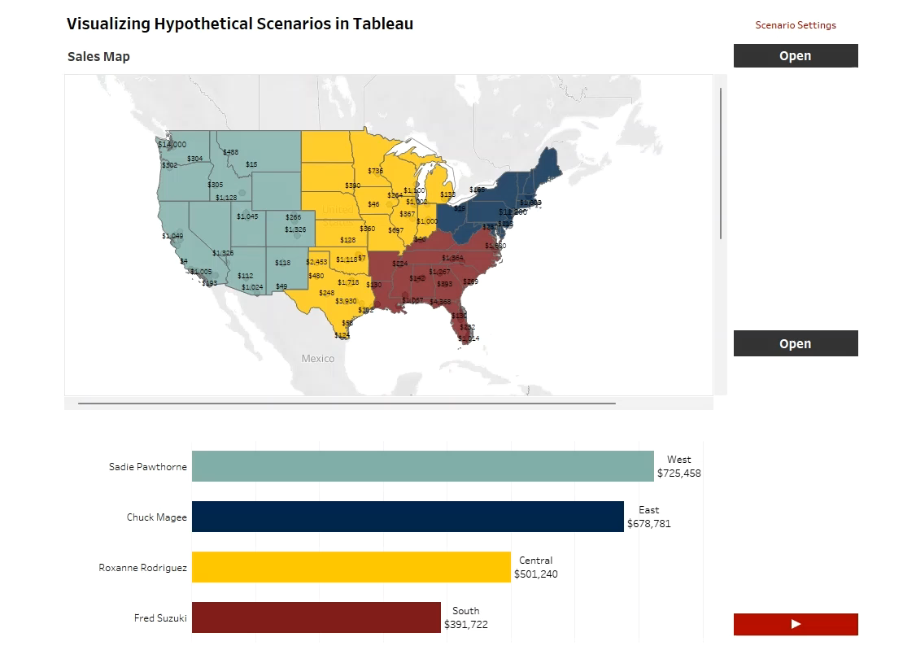
Demo
Notes:
Let’s see this more advanced model that allows us adding real-time hypothetical data and scenarios to Tableau.

Slide 10
What’s the secret?
Placeholders
Fake records with null value in the columns
Having a fake ID for identification
Examples of Fake IDs
Row # as the fake ID
Negative integer as the fake ID
Notes:
So, what’s the secret? … It is simply a smart way to use the placeholders. So, what is a placeholder?

Slide 11
How do placeholders work in Tableau?
Placeholders are added to the data set
Tableau automatically disregards the null values
Tableau Parameters receive the real-time hypothetical data from the user
Tableau Calculated Fields assign data to the placeholders (the hypothetical data only exists in the memory)
The above steps integrate real and hypothetical data together in Tableau.
Notes:
Therefore, how do placeholders work in Tableau? First, we need to add placeholder records to the data set. …

Slide 12
An Easy Way to Create Placeholders (Sample SQL)
SELECT
Orders.Row_Num*(-1) as ID
, Null as Order_ID
, Null as Order_Date
, …
FROM Orders
WHERE Orders.Row_Num <= 5
Create Fake ID
Nullify columns
Decide how many are needed
Notes:
Here is an easy way to create the placeholder records. This is a sample database query. First, we create a fake ID, then we nullify the columns, then we decide how many scenarios we need simultaneously display on Tableau.

Slide 13
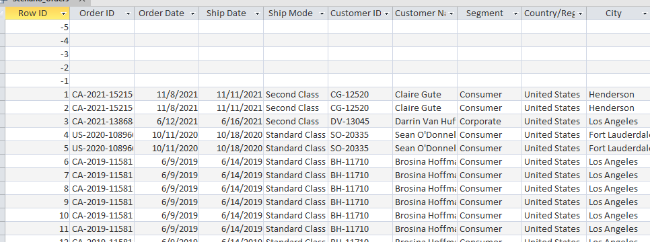
Database Tricks to Add Placeholders
SELECT * FROM Orders
UNION
SELECT * FROM Placeholder_Orders
Save as a DB View
=>Tableau Data Source
UNION statement
Notes:
Then, we use a UNION statement to stitch the placeholder records to the real dataset.

Slide 14
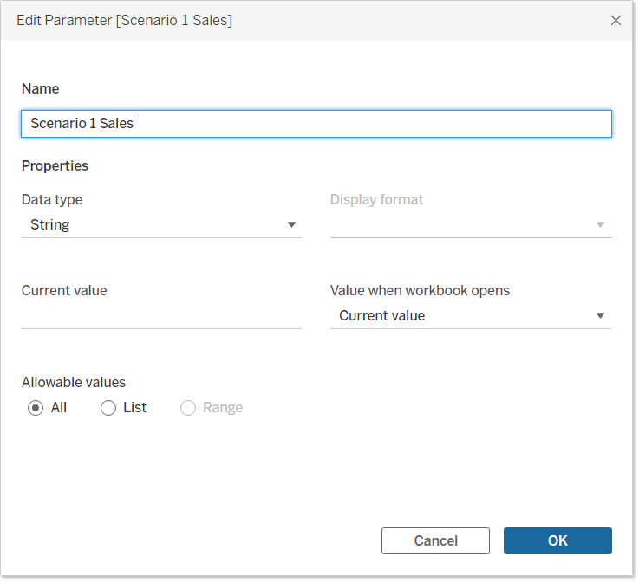
Use Parameters to Create Scenario Variables
Scenario variable
User Self-defined
Constrained discretion
Developer
pre-defined
Notes:
Use Tableau Parameters to create scenario variables. The parameters will receive real-time data from users.

Slide 15
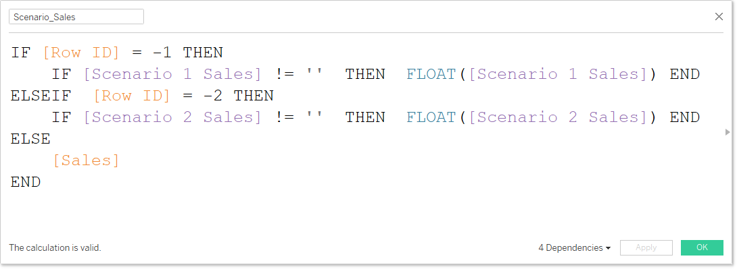
Use Calculated Fields to Assign Scenario Data
Report sales
Scenario variables
Scenario sales
Real sales
The example assumes that a maximum of two scenarios can exist concurrently.
If no data conversion is needed, the value of the scenario variable is the scenario data.
Notes:
This is an example of a Calculated Field formula. Here, we assign the hypothetical sales amount from Scenario 1 to the placeholder record with the fake ID of -1.
And we assign the hypothetical sales amount from Scenario 2 to the placeholder record with the fake ID of -2. And keep the remaining data records the same as the actual data records.

Slide 16
HE-related Use Cases
Faculty / staff salary comparisons with a hypothetical hiring
Enrollment forecasts with what-if scenario analysis
Recruitment and ethnicity distribution with hypothetical scenarios
Retirement Eligibility -- What if the staff eligible for retirement were replaced by new hires? How much budget could be saved?
Academic programs & enrollments – Showing all programs including zero enrollment programs (i.e., placeholders)
Notes:
Let’s look at some of the Higher Education-related use cases.

Slide 17
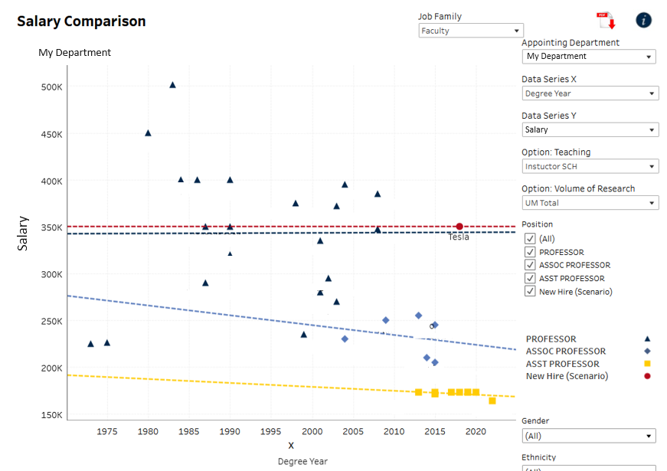
Notes:
This is an example of the Faculty Salary Comparison report.

Slide 18
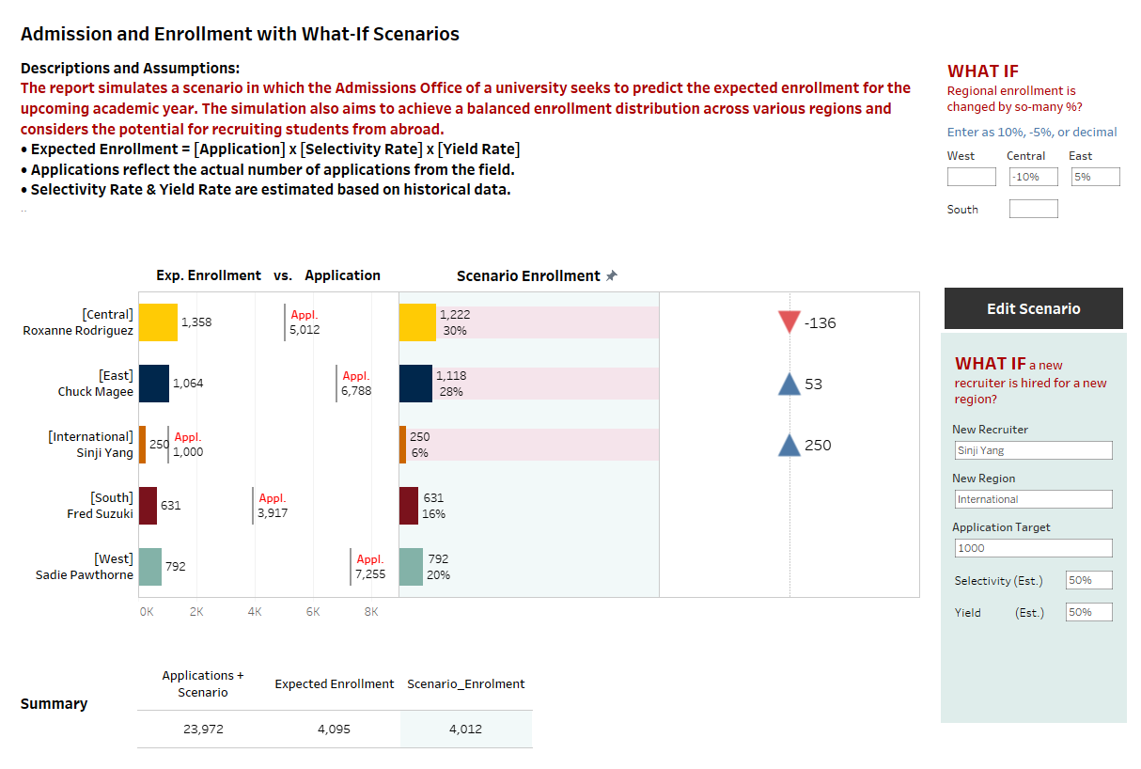
Demo

Slide 19
Considerations of Adding Scenarios
Adding scenarios will complicate the report design
Offer scenario options at a higher-level of data aggregation
Document the design and the field calculation logic
Use a naming convention to label scenario variables and data
If data download is allowed, offer a pure real data set for users to download
Use Show/hide buttons & containers to facilitate the design of a scenario settings interface or put the interface on another tab with a button jumping to and back to the report

Slide 20
Other Tips for Using Placeholders
Placeholders can keep Tableau viz steady
Avoid data table display changes when parameter selection changes
Database LEFT JOIN or CROSS JOIN can also help create placeholder records

Slide 21
Takeaways
Tableau + placeholders can help visualize real-time hypothetical data, and it is easy to add WISA to Tableau
WISA improves decision making processes and quality

Slide 22
Q & A
Contact:
Sinji Yang
sinjiya@umich.edu
Senior BI Analyst
College of Literature, Science, and the Arts
University of Michigan
Reference:
GitHub https://github.com/sinjiya/Visualizing_Real_time_Hypothetical_Scenarios_in_Tableau

